Slide 1


Bioinformatics Summer School
Long-reads Transcriptomics
Nadja Nolte and Pablo Angulo Lara
National Institue of Biology. Slovenia
Italian Institute of technology. Italy
LongTREC - The Long-reads TRanscriptome European Consortium
Marie Skłodowska-Curie grant agreement No 101072892

Slide 2
Day 3
Haplotype analysis
Allele-specific expression – fundamentals and methodology

Slide 3
INDEX
Introduction to Allele specific expression.
Long-reads VS Short reads.
ASE analysis overview.
Haplotype assembly.
Read mapping to haplotype resolved assemblies.
Haplotype-specific quantification.
Quality control.
ASE testing.
Further steps.

Slide 4
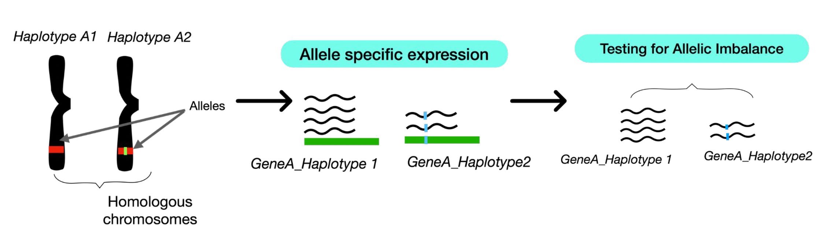
WHAT IS ALLELE-SPECIFIC EXPRESSION?
- Quantification of the expression of of the different alleles present in a gene/transcript.
- Allelic Imbalance (AI): unequal expression level between alleles.

Slide 5
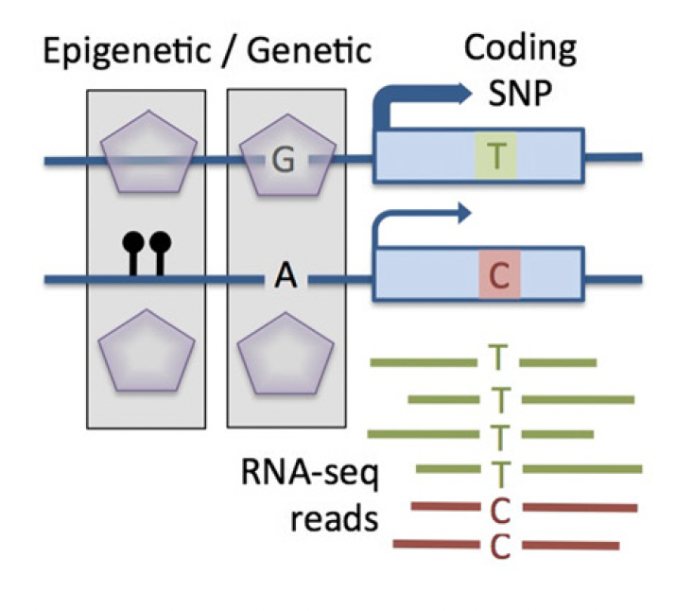
CAUSES OF ALLELIC IMBALANCE
Cis-regulatory mechanisms with epigenetic/genetic origin
Transcriptional level
Transcription factor binding site affinity.
Allele-specific DNA methylation.
Alternative-splicing.
Histone modification.
Somatic copy number variation (SCNAs).
Post-transcriptional level
Non sense mediated decay (NMD).
RNA-binding proteins (RBP).
mRNA translation rate.
Castel et al., Genome Biology, 2015

Slide 6
CAUSES OF ALLELIC IMBALANCE
Cis-regulatory mechanisms with epigenetic/genetic origin
Impact
X-chromosome inactivation.
Imprinting disorders.
Complex disease susceptibility.
Dysregulation of cancer driver genes.
Castel et al., Genome Biology, 2015

Slide 7
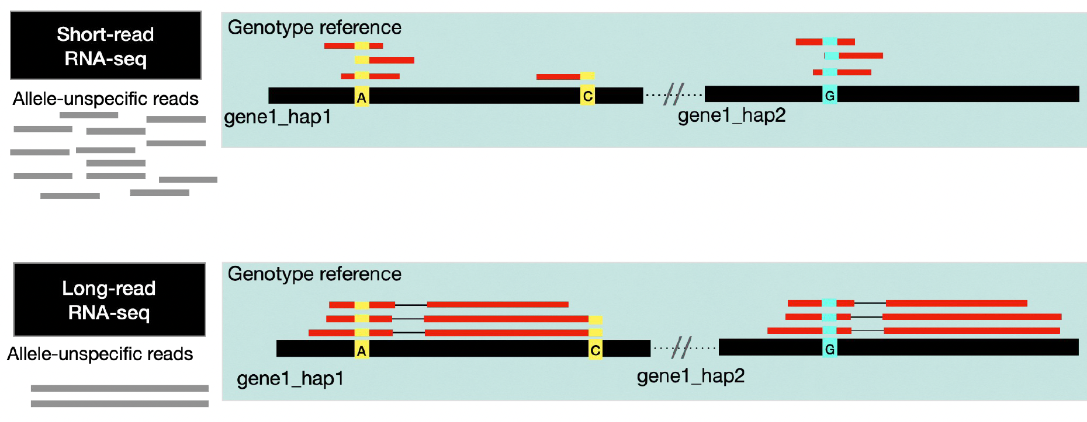
LONG READS VS SHORT READS
Advantages
Limitations
Full-length transcripts.
Enhance phasing of variants and haplotype assignment.
Less mapping bias.
Gene/Isoform level analysis.
Lower depth.
Technical variability.
Higher error rate.

Slide 8
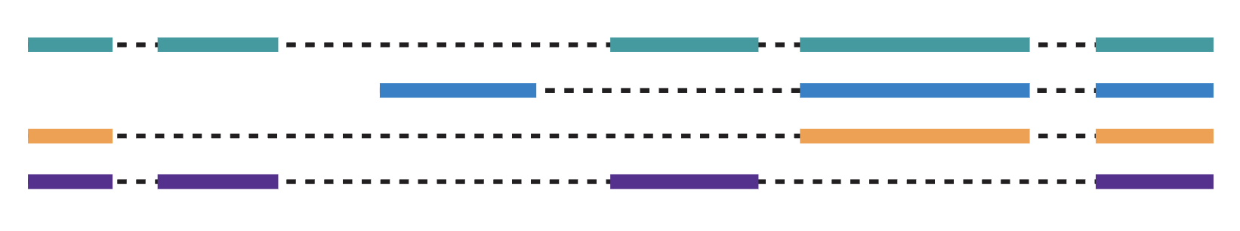


ASE ANALYSIS OVERVIEW
INPUT
Long read dataset
Reference assembly
Gene annotation (gff)
Read mapping
Haplotype specific quantification
ASE testing
Haplotype assembly
QC
Biological replicates.
Minimum coverage.
WORKFLOW

Slide 9
HAPLOTYPE ASSEMBLY
+
-
Reference assembly (Haploid)
Variant calling
Phasing
Haplotag
Reference
Reference
Reference
Reference
Updated reference with phased SNPs
Mapping bias
Analysis complexity
Hap1
Reference
Hap2
Haplotype resolved assembly
-
+
Hap1
Hap2

Slide 10
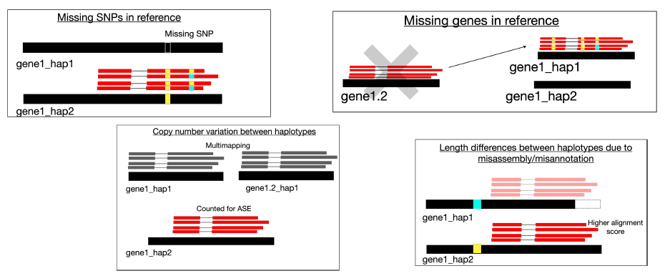
HAPLOTYPE ASSEMBLY: POTENTIAL BIASES
Check gene annotations (length, location, copies) before start the analysis

Slide 11
TO REMEMBER
Which are the main causes for allelic imbalance?
What are the benefits of using long reads for ASE analysis compared to short-read RNA-seq?
Which are the different options for haplotype assembly step?

Slide 12
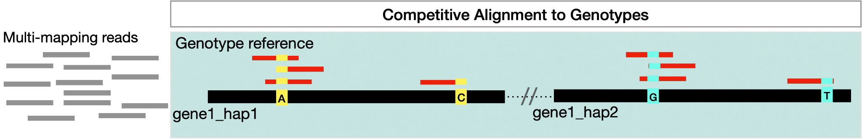
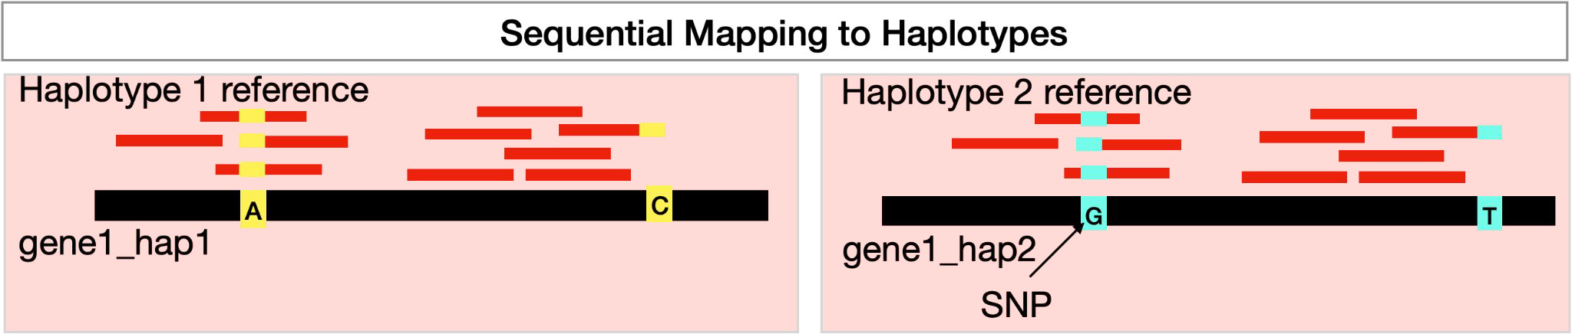
READ MAPPING
1. Mapping strategies
Important
Reads can map equally well to different locations increasing secondary alignments and MAPQ0
We don’t discard multimapping reads, secondary alignments or MAPQ0.
Mapping-score (ms) or Alignment Score (AS) can be used to evaluate alignment differences for the same read.

Slide 13
READ MAPPING
2. Selection of alignments with best mapping score
160
100
160
80
For every read, we select the alignments with best mapping-score (ms).
There can be multiple alignments with best ms (Align equally well) and MAPQ0.

Slide 14
READ MAPPING
2. Selection of alignments with best mapping score
160
160
For every read, we select the alignments with best mapping-score (ms).
There can be multiple alignments with best ms (Align equally well) and MAPQ0.

Slide 15
HAPLOTYPE-SPECIFIC QUANTIFICATION
Goal: classify reads in groups and quantify them by gene
Haplotype 1 (H1)
Read 1
Multimapping
Read 2
Haplotype 2 (H2)
Read 3
Multigene
Read 4
Gene specific (GS)

Slide 16
HAPLOTYPE-SPECIFIC QUANTIFICATION
1. Assignment of alignments to genes/isoforms
160
160
GeneA
GeneB
GeneC
GeneA
GeneB
GeneC
We can use a quantification tool to assign the alignments: FeatureCounts, Isoquant, Oarfish, etc.

Slide 17
HAPLOTYPE-SPECIFIC QUANTIFICATION
2. Classification of reads
Gene specific read (GS)
GS
GS
GeneA
GeneB
GeneC
GeneA
GeneB
GeneC
We can use a quantification tool to assign the alignments: FeatureCounts, Isoquant, Oarfish, etc.

Slide 18
HAPLOTYPE-SPECIFIC QUANTIFICATION
2. Classification of reads
GS
H2
GS
H1
H1
H2
GS
H1
H1
GS
H2
GS
H1
H1
GS
H2
H2
GeneA
GeneB
GeneC
GeneA
GeneB
GeneC
H1 - H1_multimapping - H1_multigene - H1_multimapping_multigene
H2 - H2_multimapping - H2_multigene - H2_multimapping_multigene
GS - GS _multimapping - GS _multigene - GS _multimapping_multigene
Non-haplotype-specific_complex - Non-haplotype-specific_complex_multimapping

Slide 19
HAPLOTYPE-SPECIFIC QUANTIFICATION
3. Quantification
GS
H2
GS
H1
H1
H2
GS
H1
H1
GS
H2
GS
H1
H1
GS
H2
H2
GeneA
GeneB
GeneC
GeneA
GeneB
GeneC
Gene | H1 | H2 | GS
A | 125 | 300 | 40
B | 500 | 490 | 30
C | 2 | 1 | 800
D | 30 | 700 | 2

Slide 20
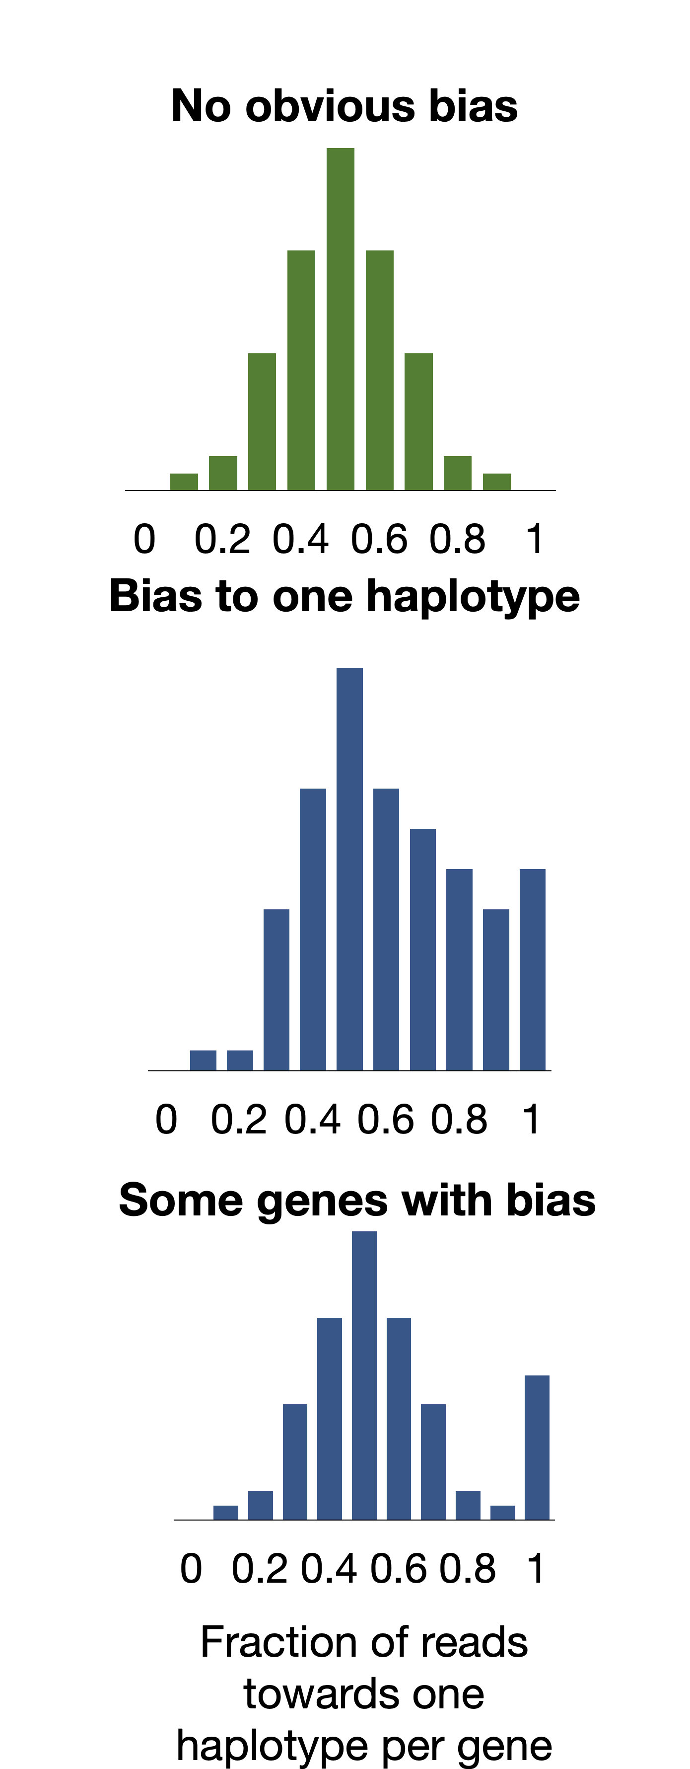
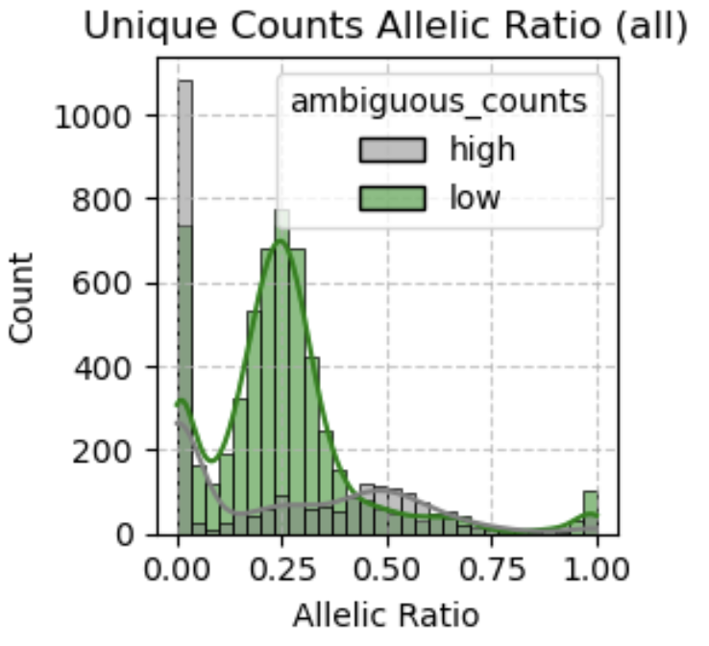
QUALITY CONTROL
Low expressed genes.
High multimapping ratio: low haplotype-specific signal.
High number of multigene assigned reads.
Mapping bias: Is there a strong bias to one of the haplotypes?
Allelic ratios (hap1/total counts)

Slide 21
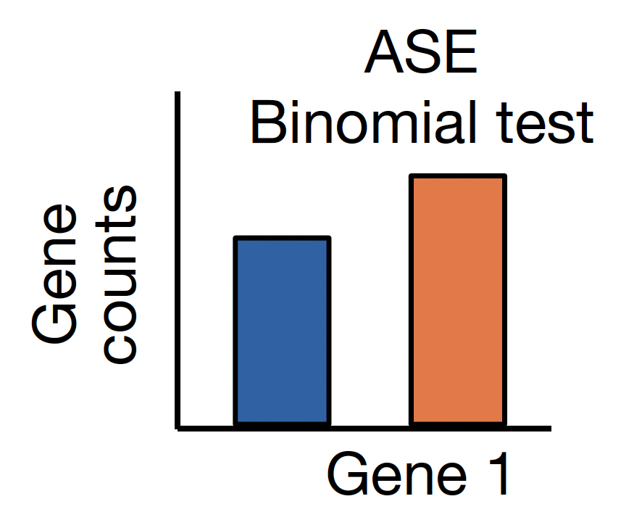
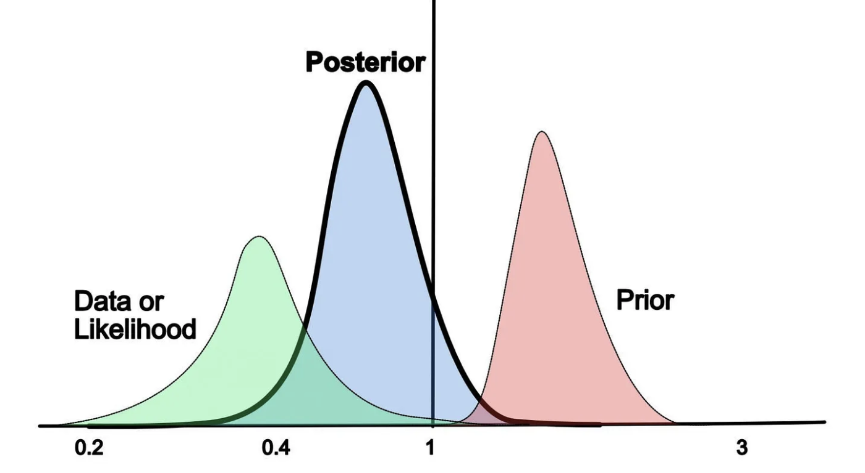
ASE TESTING
Null hypothesis: equal frequency from haplotypes.
Limitation: overdispersion.
Tools: LongcallR, LORALS, MBASED...
Binomial testing
Glinos D et al., Nature. 2022
Uses a prior distribution (genotype data or flat prior).
MCMC to calculate probability from posterior distribution.
Tools: IDP-ASE, BYASE, Skelly....
Bayesian model

Slide 22
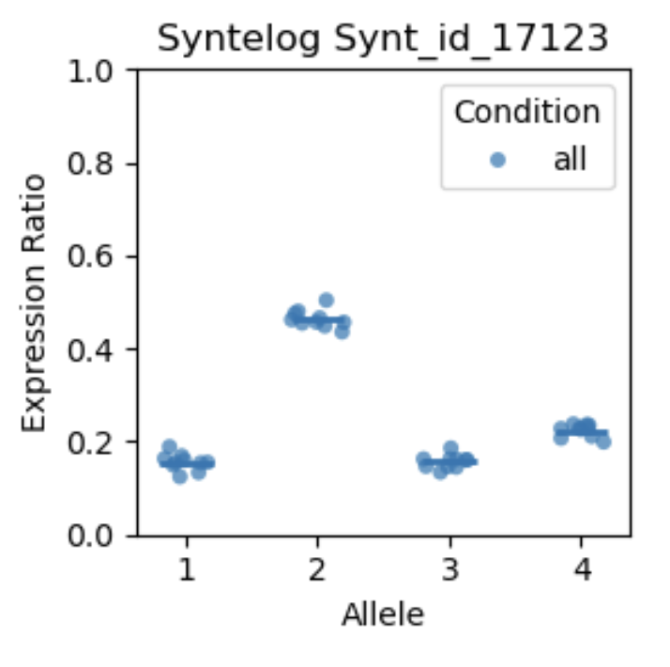
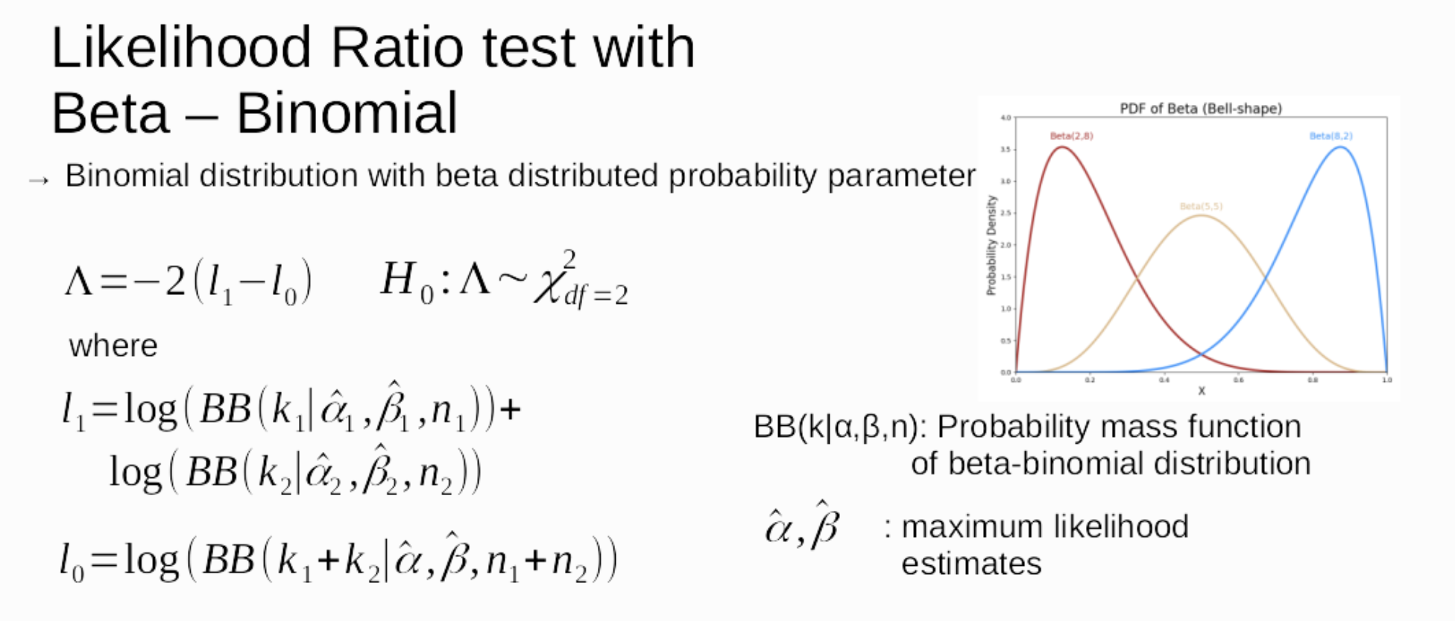
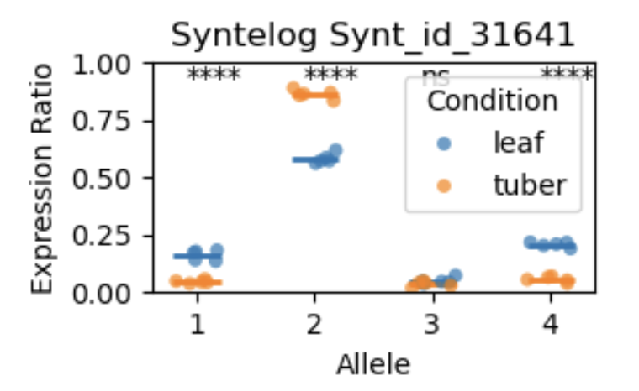
ASE TESTING
Polyase: allele-specific expression in polyploid plants
Within condition
Between conditions
Based on Isotools differential splicing test. Lienhard, M et al., Bioinformatics. 2023

Slide 23
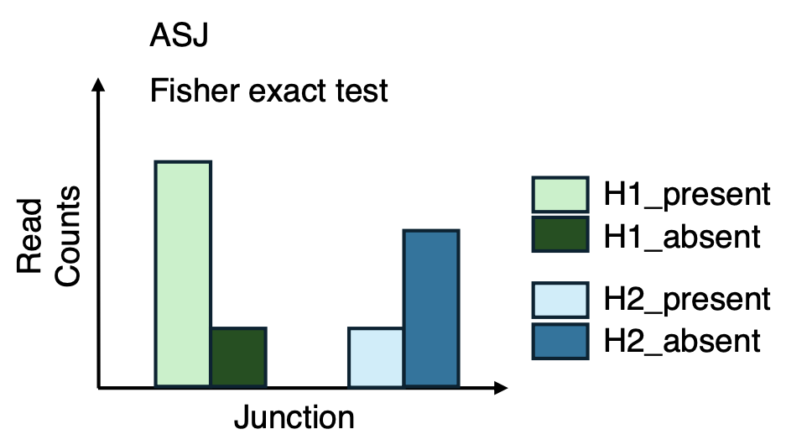
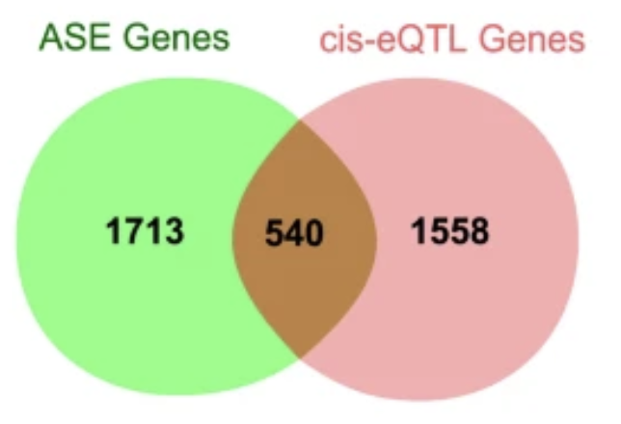
FURTHER STEPS
Differential allele-usage between isoforms
Validation of cis-eQTLs
Huang N et al., Biorxiv. 2025
Liu Y et al., Genetics Selection Evolution. 2020
Combination of ASE with overall differential gene/isoform expression.
Association of ASE with disease-related genetic variants detected with GWAS.
Detection of cis-regulatory elements (genetic variants, DNA methylation, NMD, SCNAs).

Slide 24
TO REMEMBER
Which are the main strategies for read mapping?
Which metric can we use to evaluate alignment differences by read?
How can we perform a quality control of the data before ASE testing?

Slide 25


Thank You!
For more information about the LongTREC Summer School:
https://longtrec.eu

